Slide 1



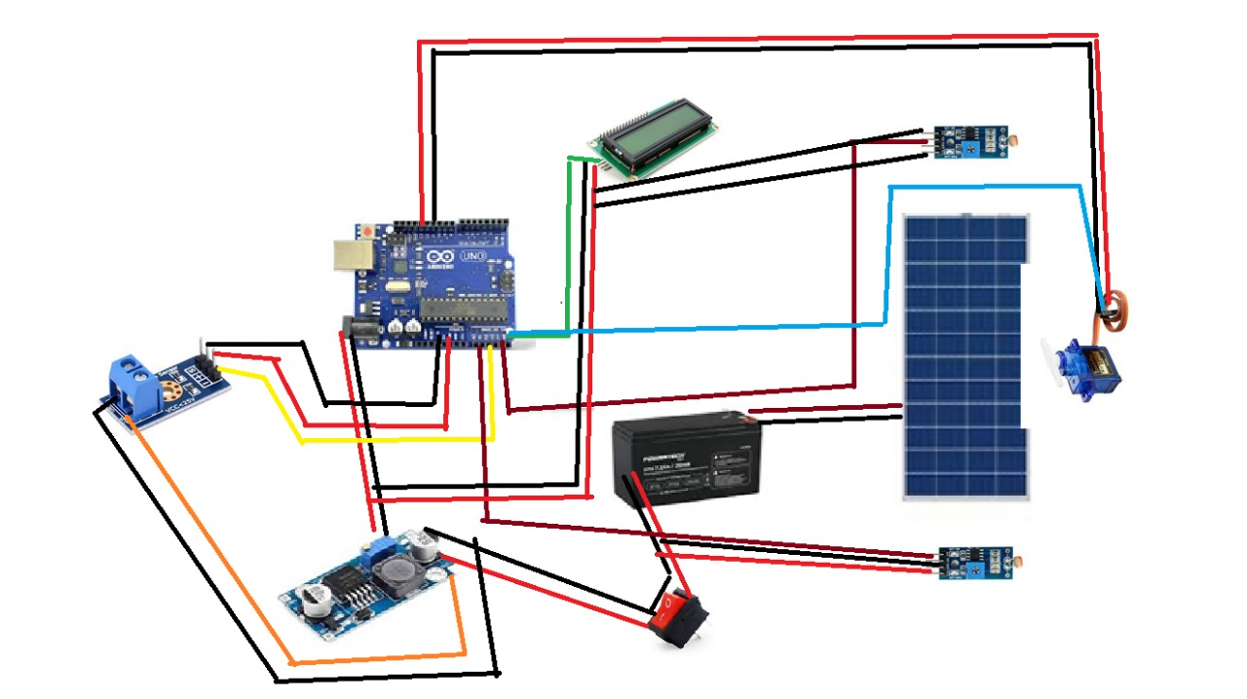
CIRCUIT DIAGRAM

Slide 2
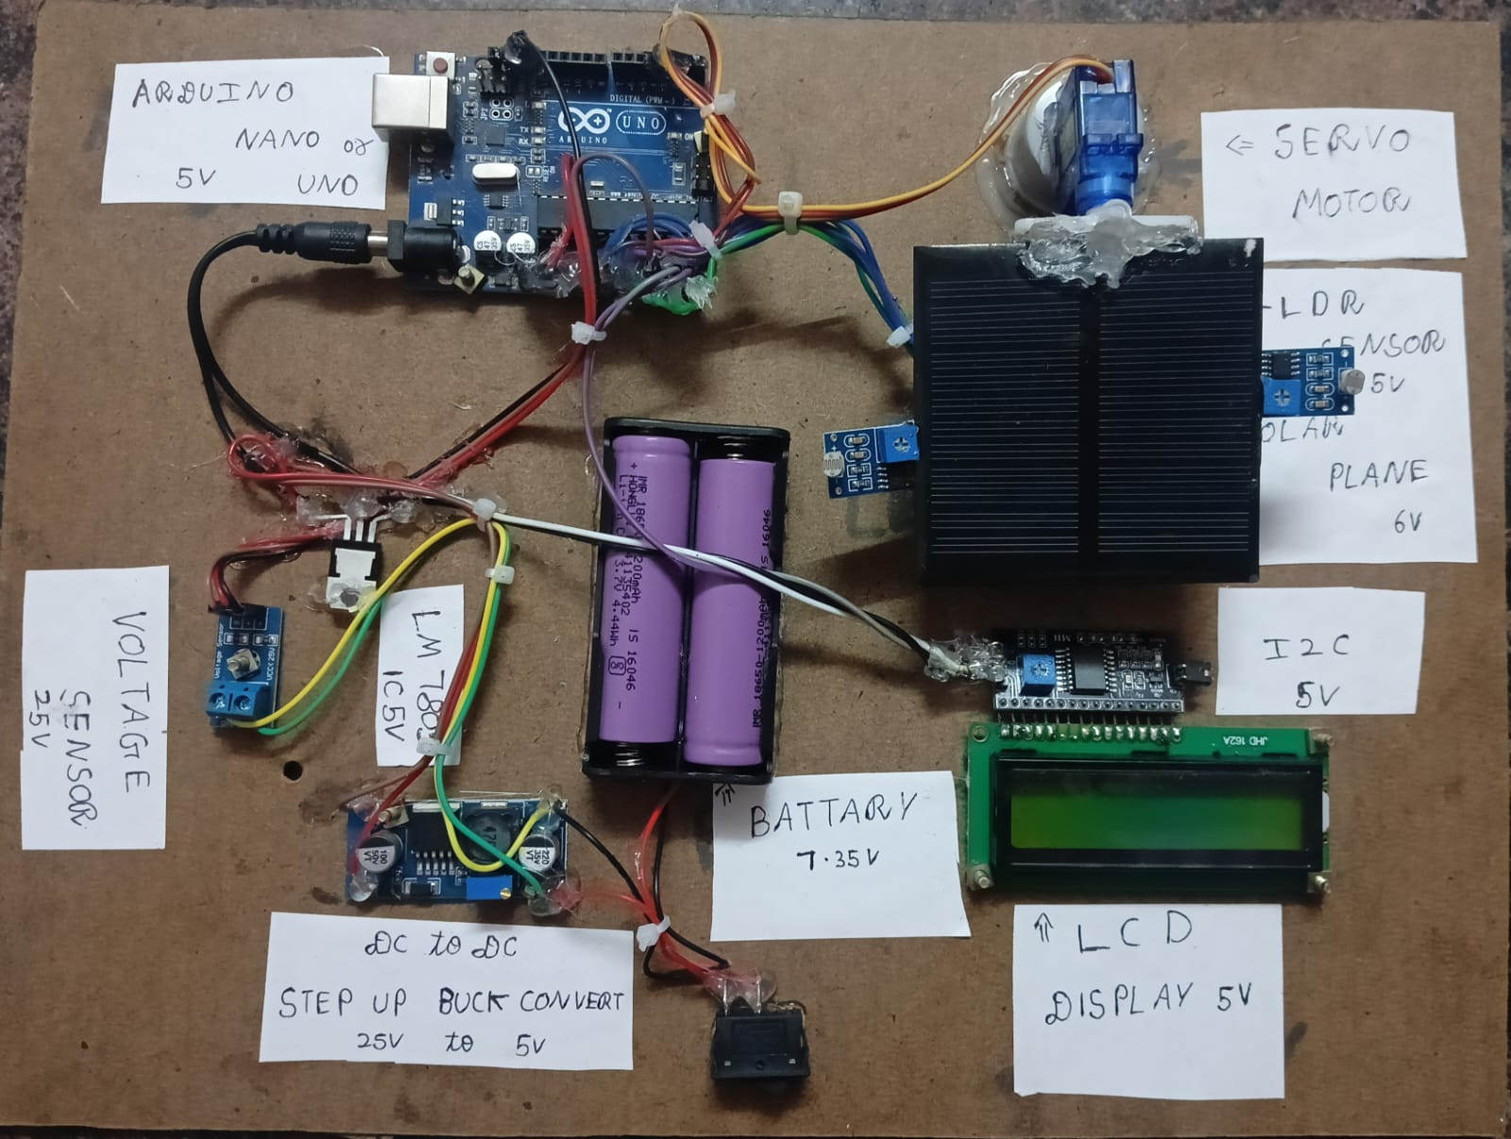
HARDWARE PHOTO

